Slide 1
Waterfall Model
To day we are going to talk about waterfall model
The most important points which we will talk about
1. Waterfall Model design 2. Waterfall Model Application
3. Advantages and Disadvantags

Slide 2
The Waterfall model is one of the best known applications of the Systems Development Life Cycle model (or SDLC), commonly used in the information systems, software, and systems engineering fields. The model is a sequential design process and gets its name from the visual depiction of progress, following the methodology looking like a waterfall

Slide 3
Waterfall Model design
Waterfall approach was first SDLC Model to be used widely in Software Engineering to ensure success of the project. In "The Waterfall" approach, the whole process of software development is divided into separate phases. In Waterfall model, typically, the outcome of one phase acts as the input for the next phase sequentially.

Slide 4
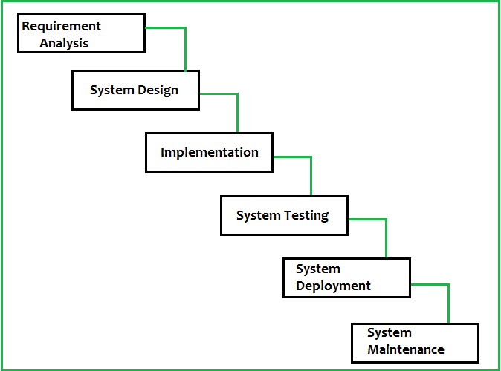

Slide 5
Waterfall Model - Application
Every software developed is different and requires a suitable SDLC approach to be followed based on the internal and external factors. Some situations where the use of Waterfall model is most appropriate are
Requirements are very well documented, clear and fixed.
Product definition is stable.
Technology is understood and is not dynamic. There are no ambiguous requirements.
The project is short.

Slide 6
Waterfall Model - Advantages
Simple and easy to understand and use
Easy to manage due to the rigidity of the model. Each phase has specific deliverables and a review process.
Clearly defined stages.
Well understood milestones.

Slide 7
Waterfall Model - Disadvantages
No working software is produced until late during the life cycle.
High amounts of risk and uncertainty.
Not a good model for complex and object-oriented projects.
Poor model for long and ongoing projects.

Slide 8
Finally, a lot of companies think they’re Agile, but an imperfect understanding of the concepts steadily pushes them back toward the perceived safety of waterfall development.

Slide 9
refrences
https://www.quora.com/Is-waterfall-design-still-widely-used
https://www.tutorialspoint.com/sdlc/sdlc_waterfall_model.htm
https://www.quora.com/What-is-an-example-of-a-waterfall-model-in-software-engineering

